Slide 1
Practical Part
Software Support for Applied Maths and Graph Theory

Slide 2
Prerequisites
I assume you have Python >= 3.7 intalled
The following packages are required
numpy (as np), scipy, networkx (as nx)
Optional: pydot (if you want to read .dot files into networkx)

Slide 3
Importing Data
Matrix Market files (.mtx)
adj_matrix = scipy.io.mmread(r'C:\path\to\file.mtx')
graph = nx.Graph(adj_matrix)
Read .dot files
graph = nx.drawing.nx_pydot.read_dot (r'C:\path\to\file.dot‘)
adj_matrix = nx.adjacency_matrix(graph)
dense_matrix = adj_matrix.todense()

Slide 4
import numpy as np

Slide 5


Vectors and Matrices
You can create vectors and matrices using the array method
vec = np.array([1, 2, 3])
mat = np.array([[1, 2, 3],
[4, 5, 6],
[7, 8, 9]])
Here vec is a one-dimensional shape, mat is a two-dimensional shape
You can also create vectors as two-dimensional shapes
rowvec = np.array([[1, 2, 3]])
colvec = np.array([[1], [2], [3]])
$$\text{r}\text{owvec}= \left[\begin{matrix}1 & 2 & 3\end{matrix}\right]$$
$$\text{colvec}=\left[\begin{matrix}1 \\ 2 \\ 3\end{matrix}\right]$$

Slide 6
Vectors and Matrices
You can query the shape of objects
np.shape(vec) = np.shape([1, 2, 3]) = (3,)
np.shape(rowvec) = np.shape([[1, 2, 3]]) = (1, 3)
np.shape(colvec) = np.shape([[1], [2], [3]]) = (3, 1)
np.shape(np.array([[[1, 2], [2, 3]], [[4, 5], [5, 6]]])) = ???
= (2, 2, 2)
np.shape(np.array([[[1, 2], [3, 4], [5, 6]]])) = ???
= (1, 3, 2)

Slide 7
Vectors and Matrices
Create a vector/matrix of all zeros or all ones
np.zeros((3,)) = [0. 0. 0.]
np.zeros((2, 3)) = [[0. 0. 0.]
[0. 0. 0.]]
[[1. 1.]
np.ones((3, 2)) = [1. 1.]
[1. 1.]]

Slide 8
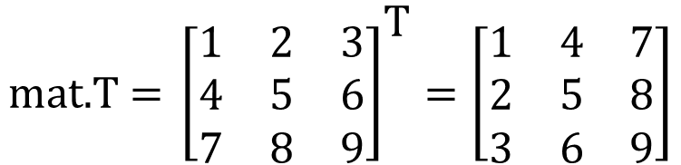
Vectors and Matrics
Transpose – „flip rows and columns“
Create a column vector out of a row vector
From a 1-dimensional shape
From a 2-dimensional shape
$${\text{mat}\text{.}\text{T}\text{ = }\left[\begin{matrix}1 & 2 & 3 \\ 4 & 5 & 6 \\ 7 & 8 & 9\end{matrix}\right]}^{\text{T}}=\left[\begin{matrix}1 & 4 & 7 \\ 2 & 5 & 8 \\ 3 & 6 & 9\end{matrix}\right]$$
[[1]
np.array([vec]).T = [2]
[3]]
[[1]
rowvec.T = [2]
[3]]

Slide 9
Addition
The operator „+“ will perform elementwise addition, e.g.
1 + vec = 1 + [1 2 3] = [2 3 4]
[[1 2 3] [[ 2 3 4]
1 + mat = 1 + [4 5 6] = [ 5 6 7]
[7 8 9]] [ 8 9 10]]
vec + vec = [1 2 3] + [1 2 3] = [2 4 6]
vec + mat = [1 2 3] + [[1 2 3] [[ 2 4 6]
[4 5 6] = [ 5 7 9]
[7 8 9]] [ 8 10 12]]
[[1] [[1 2 3] [[ 2 3 4]
colvec + mat = [2] + [4 5 6] = [ 6 7 8]
[3]] [7 8 9]] [10 11 12]]
„row-wise“
„column-wise“

Slide 10
Addition
What happens when the shapes of objects do not match, e.g., adding a 3-dimensional vector and a 2-dimensional vector
vec + np.array([1, 2]) = [1 2 3] + [1 2] = ???
ValueError: operands could not be broadcast together with shapes (3,) (2,)

Slide 11
Multiplication
The multiplication operator „*“ will perform elementwise multiplication, e.g.
2 * vec = 2 * [1 2 3] = [2 4 6]
[[1 2 3] [[ 2 4 6]
2 * mat = 2 * [4 5 6] = [ 8 10 12]
[7 8 9]] [14 16 18]]
This also works elementwise among vectors and matrices
[[1 2 3] [[ 1 4 9]
vec * mat = [1 2 3] * [4 5 6] = [ 4 10 18]
[7 8 9]] [ 7 16 27]]
[[1] [[1 2 3] [[ 1 2 3]
colvec * mat = [2] * [4 5 6] = [ 8 10 12]
[3]] [7 8 9]] [21 24 27]]
[[ 1 4 9]
mat * mat = [16 25 36]
[49 64 81]]

Slide 12
Multiplication
What happens when the shapes of objects do not match, e.g., multiplying a 3-dimensional vector and a 2-dimensional vector
vec * np.array([1, 2]) = [1 2 3] * [1 2] = ???
ValueError: operands could not be broadcast together with shapes (3,) (2,)

Slide 13
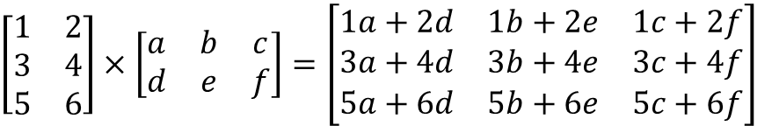
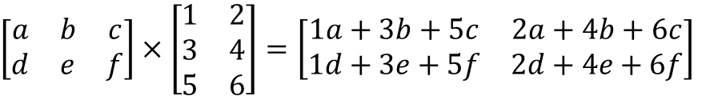
Multiplication
Remember matrix multiplication?
The order matters!
Matrix with (rows, columns)
(N,M) x (M,N) = (N,N)
$\left[\begin{matrix}1 & 2 \\ 3 & 4 \\ 5 & 6\end{matrix}\right]×\left[\begin{matrix}a & b & c \\ d & e & f\end{matrix}\right]=\left[\begin{matrix}1a+2d & 1b+2e & 1c+2f \\ 3a+4d & 3b+4e & 3c+4f \\ 5a+6d & 5b+6e & 5c+6f\end{matrix}\right]$
$\left[\begin{matrix}a & b & c \\ d & e & f\end{matrix}\right]×\left[\begin{matrix}1 & 2 \\ 3 & 4 \\ 5 & 6\end{matrix}\right]=\left[\begin{matrix}1a+3b+5c & 2a+4b+6c \\ 1d+3e+5f & 2d+4e+6f\end{matrix}\right]$

Slide 14
Multiplication
The multipliation operator „@“ will perform matrix multiplication, alternatively „.dot(…)“ or „np.matmul(…)“ may be used
[[1 2 3]
vec @ mat = [1 2 3] @ [4 5 6] = [30 36 42]
[7 8 9]]
Beware that order matters
[[1 2 3] [[1]
Mat @ vec = [4 5 6] @ [2] = [14 32 50]
[7 8 9]] [3]]
„vec is seen as row-vector“
„vec is seen as column-vector“

Slide 15
Multiplication
What happens if shape dimensions do not match?
mat @ rowvec = ???
ValueError: matmul: Input operand 1 has a mismatch in its core dimension 0, with gufunc signature (n?,k),(k,m?)->(n?,m?) (size 1 is different from 3)

Slide 16

Sums
Sum of a matrix
mat.sum()
45
Columsum of matrix
mat.sum(axis = 0)
[12 15 18]
Rowsum of a matrix
mat.sum(axis = 1)
[6 15 25]
mat.sum(axis = 1, keepdims = True)
[[ 6]
[15]
[24]]
mat = $\left[\begin{matrix}1 & 2 & 3 \\ 4 & 5 & 6 \\ 7 & 8 & 9\end{matrix}\right]$

Slide 17
More Complex Manipulations
Normalizing columns of a matrix
smat = mat / mat.sum(axis = 0)
[[1 2 3]
smat = [4 5 6] / [12 15 18]
[7 8 9]]
[[0.08333333 0.13333333 0.16666667]
smat = [0.33333333 0.33333333 0.33333333]
[0.58333333 0.53333333 0.5 ]]

Slide 18
More Complex Manipulations
Normalizing rows of a matrix
smat = mat / mat.sum(axis = 1)
[[1 2 3]
smat = [4 5 6] / [ 6 15 24]
[7 8 9]]
[[0.16666667 0.13333333 0.125 ]
smat = [0.66666667 0.33333333 0.25 ]
[1.16666667 0.53333333 0.375 ]]
0.425
1.25
2.075
Ooops!!

Slide 19
More Complex Manipulations
Normalizing rows of a matrix (correct)
smat = mat / mat.sum(axis = 1, keepdims = True)
[[1 2 3] [[ 6]
smat = [4 5 6] / [15]
[7 8 9]] [24]]
[[0.16666667 0.33333333 0.5 ]
smat = [0.26666667 0.33333333 0.4 ]
[0.29166667 0.33333333 0.375 ]]

Slide 20
import networkx as nx

Slide 21
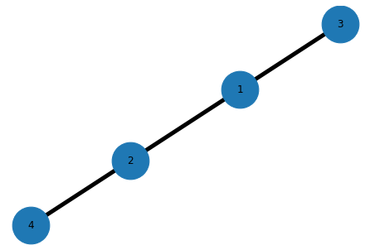
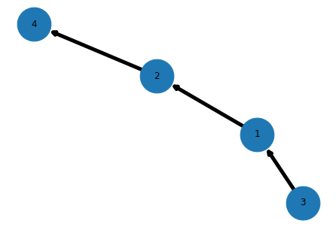
Create a graph
Graph from an edge list:
graph = nx.Graph([(1, 2), (3, 1), (2, 4)])
nx.draw(graph, with_labels = True)
Graph with directed edges from an edge list:
digraph = nx.Digraph([(1, 2), (3, 1), (2, 4)])
nx.draw(digraph, with_labels = True)
Additional parameters to draw: node_size = 2000, width = 5

Slide 22
Create a graph
By adding nodes manually
graph.add_node(5)
By adding edges manually
graph.add_edge(1, 5)
graph.add_edges_from([(3, 5), (2, 5)])

Slide 23
Iterate over a graph
Iterate over the nodes
for n in graph:
print(n)
print (len(graph.nodes()))
1
2
3
4
4

Slide 24
Iterate over a graph
Iterate over the edges
for (u, v) in graph.edges():
print(u, " -> ", v)
for (u, v) in digraph.edges():
print(u, " -> ", v)
for e in digraph.edges():
print(e[0], " -> ", e[1])
1 -> 2
1 -> 3
-> 4
1 -> 2
3 -> 1
3 -> 4
Remember we defined it as (3, 1)

Slide 25
Iterate over a graph
Finding neighbors of a node
for n in graph[1]:
print(n)
When node does not exist
for n in graph['a']:
print(n)
2
3
KeyError: 'a'

Slide 26
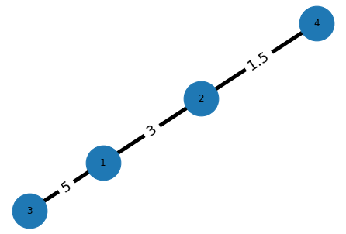
Create Weighted Graphs
By adding edges with weights
G = nx.Graph()
G.add_edge(1, 2, weight=3)
G.add_edge(3, 1, weight=5)
G.add_edge(2, 4, weight=1.5)
pos = nx.spring_layout(G)
nx.draw(G, pos, with_labels = True)
labels = nx.get_edge_attributes(G, 'weight')
nx.draw_networkx_edge_labels(G, pos, edge_labels = labels, font_size = 18)

Slide 27
Heaps in Python

Slide 28
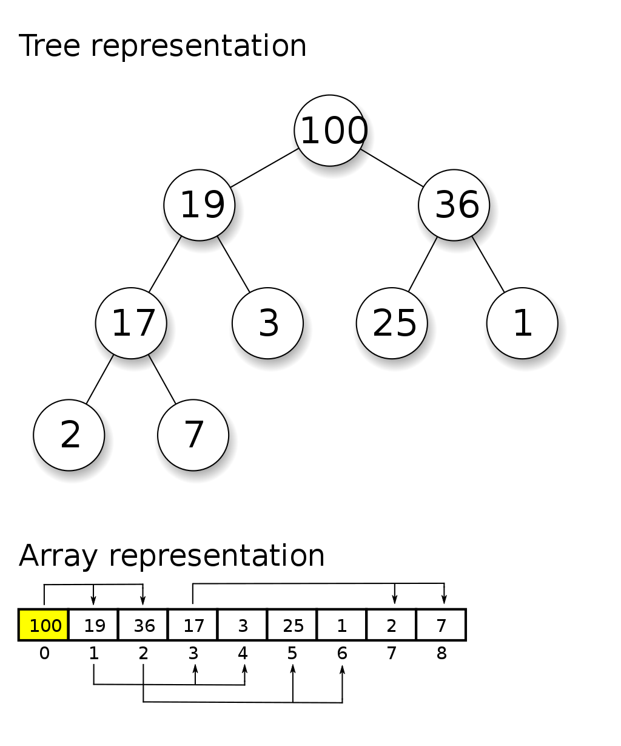
What‘s a Heap?
A Heap is a tree-based data structure
Max (min) heap property: Every parent node has an equal or larger (smaller) key than its children
Most commonly implemented heaps are based on binary trees (max two children per parent)
Most common usage when you need a dynamic data structure that returns the largest (smallest) item in log(N) time
Source: https://en.wikipedia.org/wiki/Heap_(data_structure)

Slide 29
Python - heapq
Most commonly used operations
import heapq
imports the class
Min-Heap (for a max-heap multiply your priorities with -1)
heapq.heappush(heap, item)
Adds an item to the heap
Items are numbers or tuples with the number (key) first, e.g. (0, 'priority zero')
heapq.heappop(heap)
Retrieves the minimum item
heapq.heapify(list)
Turns the list into a heap

Slide 30
Python – heapq – Examples
Generating heap from list
tasks = [ (3, 'prepare for AMS4'), (9, 'buy stuff'), (6, 'groceries'), (5, 'house cleaning'), (4, 'wash clothes') ]
heapq.heapify(tasks)
for x in tasks:
print(x)
Output
(3, 'prepare for AMS4')
(4, 'wash clothes')
(6, 'groceries')
(5, 'house cleaning')
(9, 'buy stuff')
A heap is not a sorted list

Slide 31
Python – heapq – Examples
Get them in ascending order
tasks = [ (3, 'prepare for AMS4'), (9, 'buy stuff'), (6, 'groceries'), (5, 'house cleaning'), (4, 'wash clothes') ]
heapq.heapify(tasks)
for x in range(len(tasks)):
print(heapq.heappop(tasks))
Output
(3, 'prepare for AMS4')
(4, 'wash clothes')
(5, 'house cleaning')
(6, 'groceries')
(9, 'buy stuff')
heappop elements one by one -> sorted output

Slide 32
Python – heapq – Examples
Manipulation
tasks = [ (3, 'prepare for AMS4') ]
heapq.heappush(tasks, (9, 'buy stuff')) heapq.heappush(tasks, (6, 'groceries'))
for x in tasks:
print(x)
print("Done:", heapq.heappop(tasks)[1])
heapq.heappush(tasks, (5, 'house cleaning')) heapq.heappush(tasks, (4, 'wash clothes'))
heapq.heapify(tasks)
for x in range(len(tasks)):
print("Done:", heapq.heappop(tasks)[1])
Output
(3, 'prepare for AMS4')
(9, 'buy stuff')
(6, 'groceries')
Done: prepare for AMS4
Done: wash clothes
Done: house cleaning
Done: groceries
Done: buy stuff

Slide 33
Python – heapq – Examples
What if heapify is omitted?
tasks = [
(9, 'buy stuff'),
(6, 'groceries'),
(5, 'house cleaning'),
(1, 'answer phone'),
(4, 'wash clothes'),
(3, 'prepare for AMS4')
]
# oops, forgot heapq.heapify(tasks)
for x in range(len(tasks)):
print("Done:", heapq.heappop(tasks))
Output
Done: (9, 'buy stuff')
Done: (3, 'prepare for AMS4')
Done: (4, 'wash clothes')
Done: (1, 'answer phone')
Done: (5, 'house cleaning')
Done: (6, 'groceries')
:-D
missed call, dang
9
6
5
1
4
3
tasks does not satisfy the heap property!

Slide 34
Python – heapq – Examples
What if heapify is omitted?
tasks = [
(1, 'answer phone'),
(3, 'prepare for AMS4'),
(6, 'groceries'),
(5, 'house cleaning'),
(4, 'wash clothes'),
(9, 'buy stuff')
]
# oops, forgot heapq.heapify(tasks)
for x in range(len(tasks)):
print("Done:", heapq.heappop(tasks))
Output
Done: (1, 'answer phone')
Done: (3, 'prepare for AMS4')
Done: (4, 'wash clothes')
Done: (5, 'house cleaning')
Done: (6, 'groceries')
Done: (9, 'buy stuff')
1
3
6
5
4
9
tasks satisfies the heap property!

